Slide 1
IOT_PHASE 5
Environmental Monitoring

Slide 2


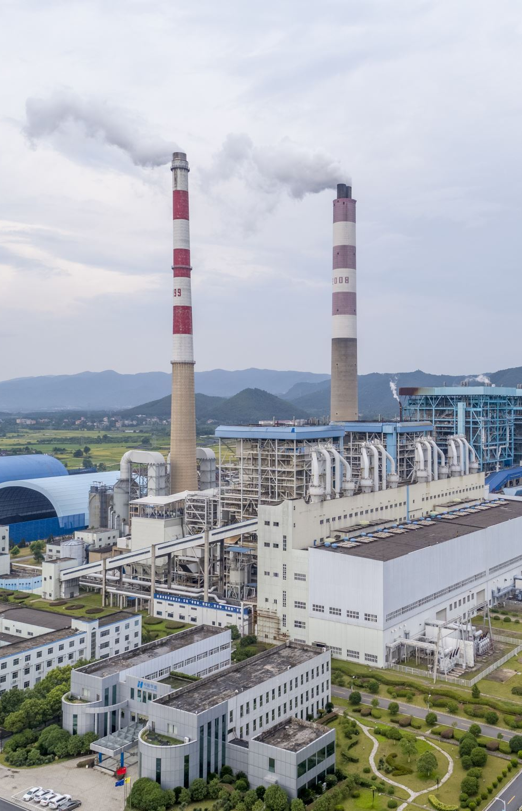

Environmental Data Collection:
Abstract—Air quality is getting worse worldwide, especially
in cities with high population density and many industrial parks.
Raising community awareness and applying science and
technology are effective ways to mitigate the negative impacts of
industrialization and pollution on the natural environment as
well as public health. This work presents the design and
deployment of an IoT-based air quality monitoring system,
named the Environmental Monitoring System (EnMoS). LoRa
(Long-Range) wireless communication technology and
innovation sensors being used aim to facilitate the development
of data communication network over a large area, improving
sensing reliability, extending battery life as well as reducing
total system costs.

Slide 3
.
Climate change has been causing significant impacts on
people’s living conditions, stability, and socio-economic
development status in the Lower Mekong River Basin day by
day. Besides, due to population growth, the rapid increase of
industrialization, as well as indiscriminate use of chemical
fertilizers and pesticides in agriculture, are causing serious
impacts on the environment, climate, and public health.

Slide 4
Real-time Data Display:
The practical applications of real-time environmental monitoring are vast and varied. Wildfires, landslides, flooding, biodiversity, and waste and pollution are all issues of increasing concern as the climate crisis is predicted to worsen in coming years. Wildfire monitoring systems have been particularly useful in 2020, which saw a record-setting number of wildfires ravage California.
Real-time sensor data combined with data science and advanced analytics tools facilitate high visibility and granular analysis of environmental phenomena. The most common environmental monitoring types include air, soil, and water:

Slide 5
REMAS provides US Navy personnel and stakeholders tools to support 24/7/365 situational awareness and contributes to mission planning, decision support, routine operations, test evaluation, ordnance and test safety, forensics, and disaster recovery.
REMAS provides outstanding indoor and outdoor environmental and weather awareness for ordnance development and test programs:
Thermal conditioning monitoring
Real-time multi-scale measurement and analysis
Site- and mission-specific weather forecasting
Results synthesized and displayed for at-a-glance understanding
Reduce cost; improve safety
Enables high-confidence preemptive scheduling to avoid adverse weather
z

Slide 6
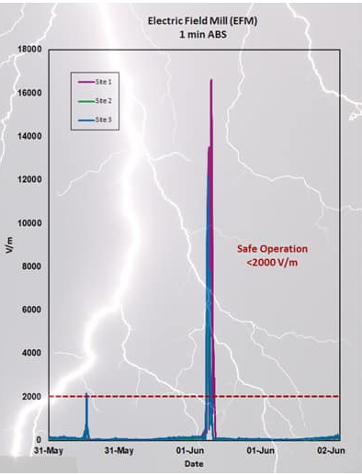
.
z

Slide 7
Alert System:
Traditionally, “alerts” have been used to indicate that something significant has happened or may happen, while “warnings” typically follow alerts and provide more detail information indicating what protective action should be taken. However, the distinction between the two terms has blurred over time, as a more nuanced understanding of people’s need for information and response to that information has emerged and as new communications technologies that can transmit both types of messages have come into use.
National Academies of Sciences, Engineering, and Medicine. 2018. Emergency Alert and Warning Systems: Current Knowledge and Future Research Directions. Washington, DC: The National Academies Press. https://doi.org/10.17226/24935.

Slide 8
.he purpose of alerts and warnings is to provide the necessary information to warn the public and effect the necessary actions that will lead to their safety and to deliver the messages to populations at risk of imminent threats with the goal of maximizing the probability that people take protective actions and minimize the delay in taking those actions.
National Academies of Sciences, Engineering, and Medicine. 2018. Emergency Alert and Warning Systems: Current Knowledge and Future Research Directions. Washington, DC: The National Academies Press. https://doi.org/10.17226/24935.
z

Slide 9
Promotion of Outdoor Activities
Better physical health
Numerous opportunities to strengthen motor skills
Stress relief
Greater visual-motor integration (or the ability to control hand or body movement guided by vision)
Greater creativity
Stronger verbal and social skills
Production of vitamin D (an essential vitamin for bone health) through exposure to sunlight
Increased attention and cognitive abilities

Slide 10
Continually evaluate your outdoor learning environment to ensure the equipment is safe and the environment is free from preventable risks. You must consider fall zones, surfacing, access to shade, and the conditions of materials and equipment.
Look for these items and correct them before children and youth are permitted to play:
Missing or broken parts
Protrusion of nuts and bolts
Rust and chipping or peeling paint
Sharp edges, splinters, and rough surfaces
Unstable handholds
Visible cracks
Unstable non-anchored large play equipment (e.g., playhouses, climbers)
Wear and deterioration
Broken or worn electrical fixtures or cords
z

Slide 11
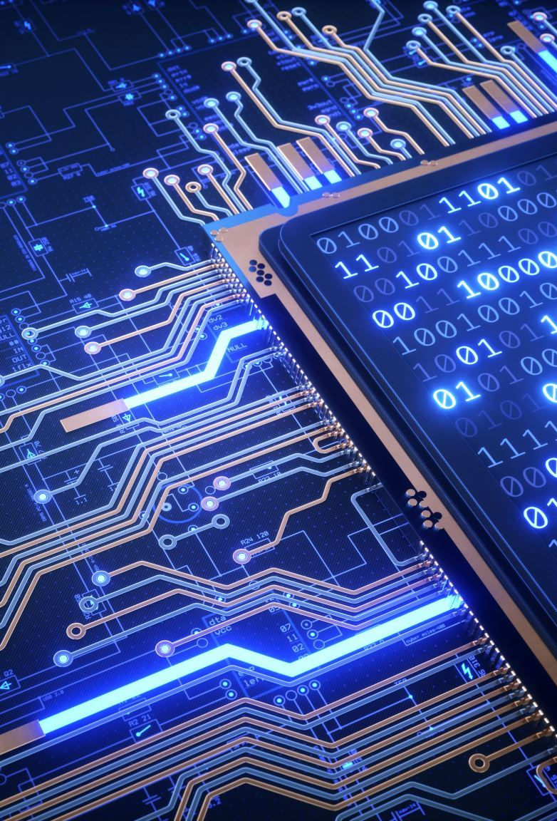
IoT Device Deployment
To achieve the project's objectives, a network of IoT devices is deployed in various locations within the parks. These devices are strategically placed to capture data from different areas, ensuring a comprehensive view of the park's environmental conditions. The IoT devices include sensors for temperature, humidity, air quality (particulate matter and gas levels), and noise levels. They communicate data to a central server via wireless connectivity (e.g., Wi-Fi or LoRa).

Slide 12
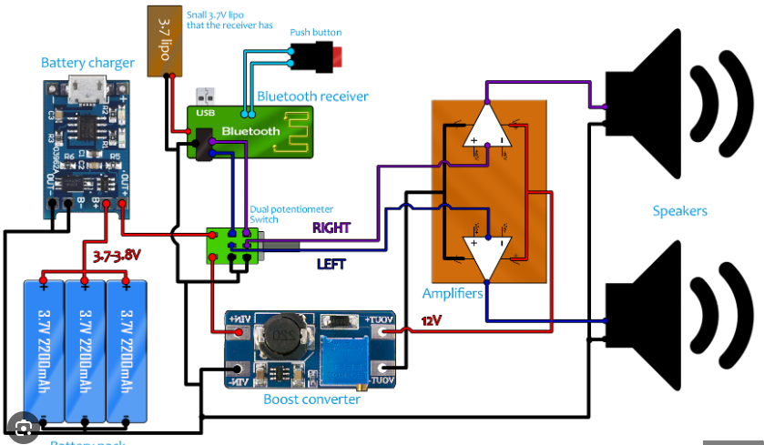
.
z

Slide 13
Platform Development
The project involves the development of a web-based platform to collect, process, and display the environmental data. The platform provides a user-friendly interface for park visitors and park management to access real-time data, historical trends, and alerts.
Platform Architecture

Slide 14
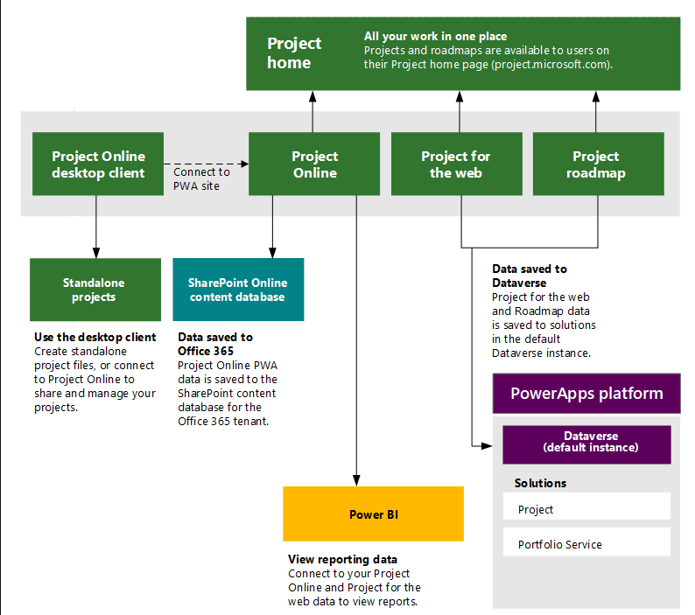
.
z

Slide 15

Code Implementation
The codebase for this project is divided into two main components:
IoT Device Firmware
Web-based Platform
IoT Device Firmware: This code handles data acquisition from the sensors, packaging data, and transmitting it to the central server. It also manages low-power operation to extend device battery life.
IoT Device Firmware: This code handles data acquisition from the sensors, packaging data, and transmitting it to the central server. It also manages low-power operation to extend device battery life.

Slide 16
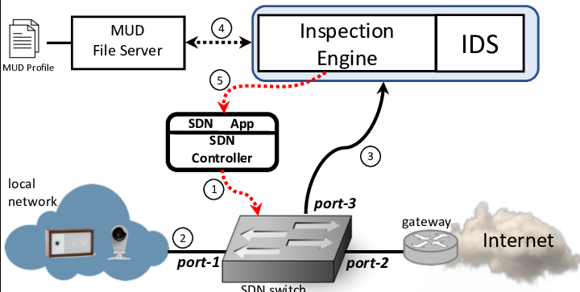
.
z

Slide 17

.
z

Slide 18
Real-time Environmental Monitoring Benefits
The real-time environmental monitoring system offers several benefits to park visitors and promotes outdoor activities:
Improved Safety: Visitors can stay informed about weather conditions, air quality, and noise levels, allowing them to make informed decisions and avoid potential health risks.
Enhanced Experience: Real-time data enables visitors to plan their activities, such as picnics, hiking, or outdoor events, based on current environmental conditions.

Slide 19
Sustainability Promotion: Park management can use data to implement eco-friendly practices, such as adjusting irrigation based on real-time weather data and reducing energy consumption.
Educational Tool: The system can serve as an educational tool by providing insights into how the environment changes over time and the impact of human activities.
Community Engagement: Visitors can share their experiences and environmental data via social media, fostering community engagement and increasing park attendance.
z

Slide 20
In conclusion, the Environmental Monitoring in Parks project combines IoT device deployment, platform development, and real-time data display to enhance the park experience for visitors while promoting outdoor activities and sustainable park management.
z

Slide 21

.
z

